Slide 1
RRC:Connection Control
Overview
Tejaram S
EE19E011
Nitin Priyadarshini Shankar EE19E010

Slide 2
Abbreviations
NR New Radio
RRC Radio Resource Control
RAN Radio Access Network
LTE Long Term Evolution
E-UTRA Evolved – Universal Terrestrial Radio Access
GSM Global Systems for Mobile Communications
PHY Physical Layer
MAC Medium Access Control
RLC Radio Link Control

Slide 3
PDCP Packet Data Convergence Protocol
AS Access Stratum
PUCCH Physical Uplink Control Channel
SRS Sounding Reference Signal
SRB Signalling Radio Bearer
MIB Master Information Block
BCH Broadcast Channel
DL-SCH Downlink-Shared Channel
SSB Synchronization Signal Block
CORESET Control Resource Set
SI System Information

Slide 4
RNTI Radio Network Temporary Identifier
5GC 5G Core Network
RNA RAN-based Notification Area
MR-DC Multi-Radio Dual Connectivity
P-CELL Primary Cell
CSI Channel State Information
PUCCH Physical Uplink Control Channel
IE Information Element

Slide 5
Table of Contents
Introduction
Paging
RRC Connection Establishment
Initial AS Security Activation
RRC Reconfiguration
Counter Check
RRC Connection re-establishment
RRC Connection release
RRC Connection release requested by upper layers
Radio link failure related actions
UE actions upon going to RRC_IDLE
UE actions upon going to PUCCH/SRS release
RRC Connection resume
Unified Access Control
RRC Connection reject

Slide 6
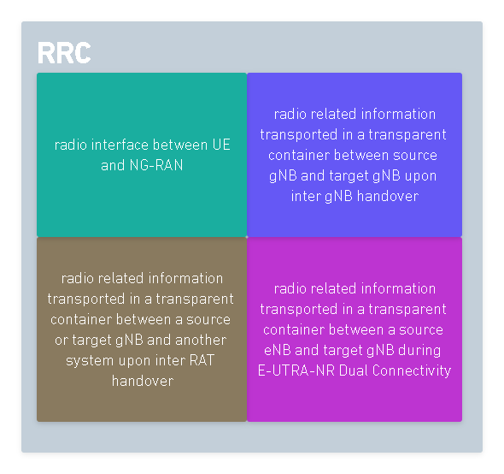
Introduction
The major role of RRC is to control(configure) all the Radio Resources (PHY, MAC, RLC, PDCP) to make it possible to communicate between UE and the base station.
In NR, RRC can also interact with RRC of other RAN namely:
E-UTRA (4G)
UTRA (3G)
GSM (2G)
RRC Functions

Slide 7
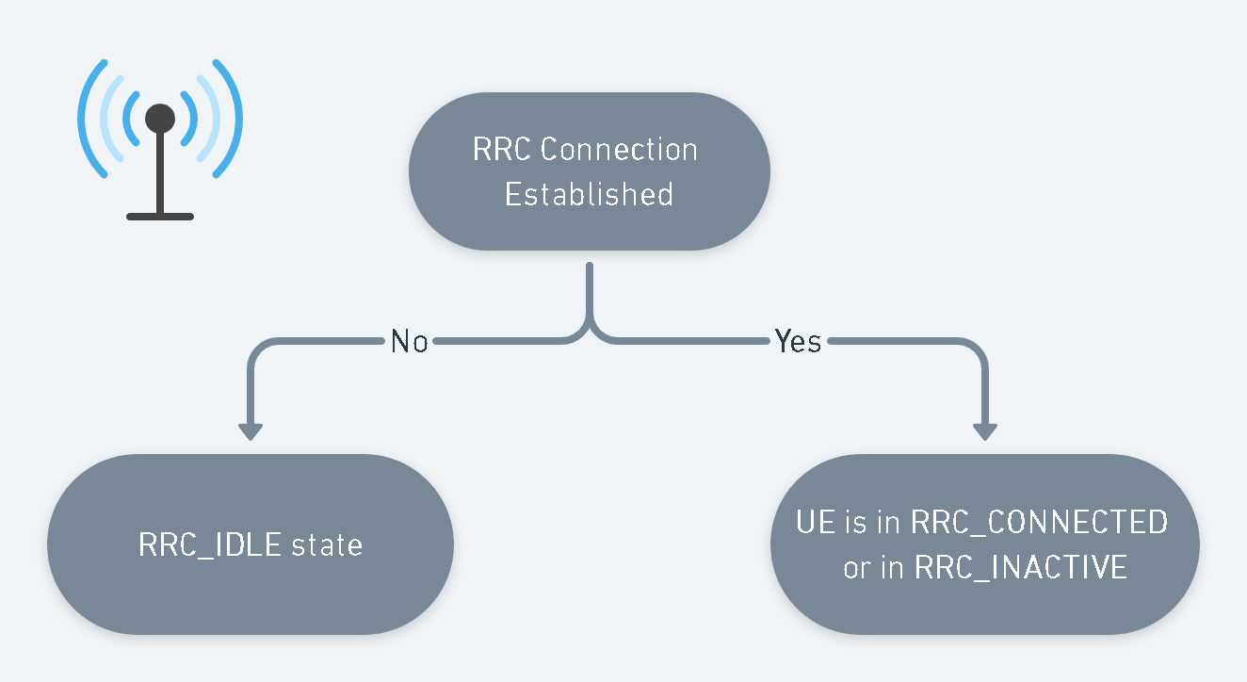
In NR, there are three RRC states UE can be present. A UE has only one RRC state in NR at one time.
RRC States

Slide 8
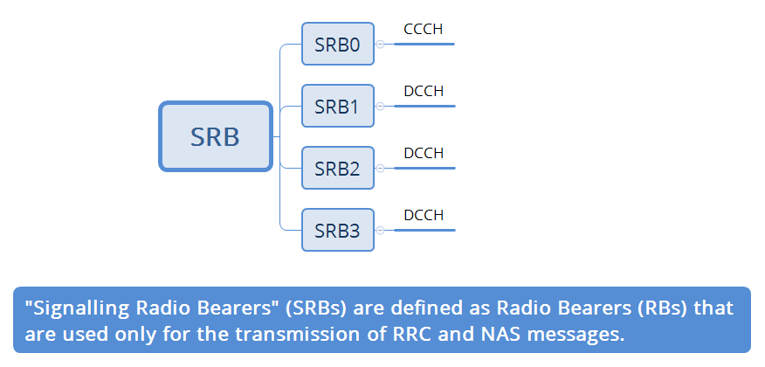
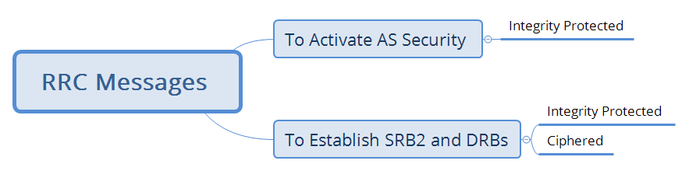

Slide 9
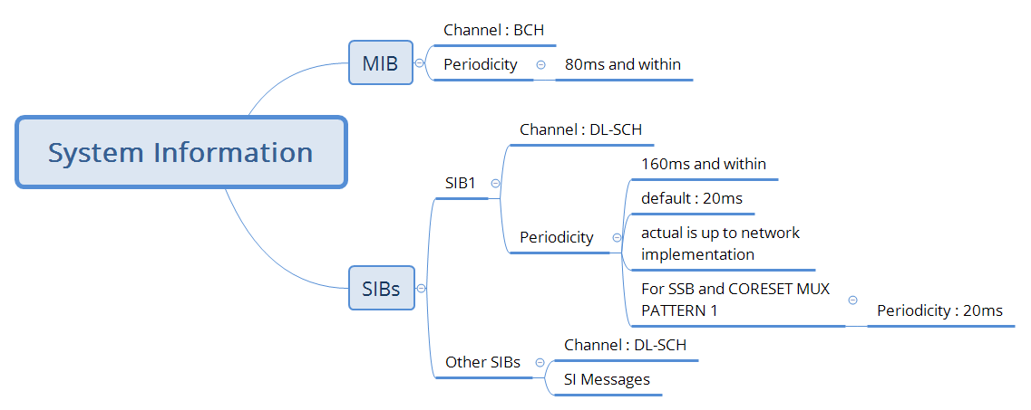

Slide 10
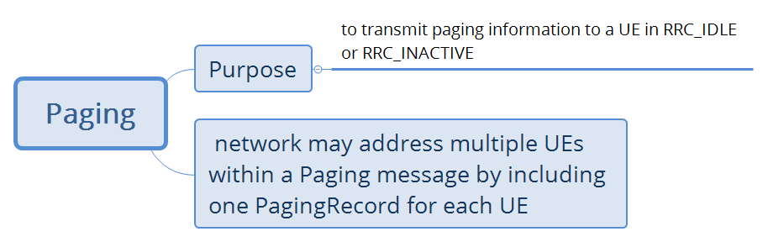
Paging

Slide 11
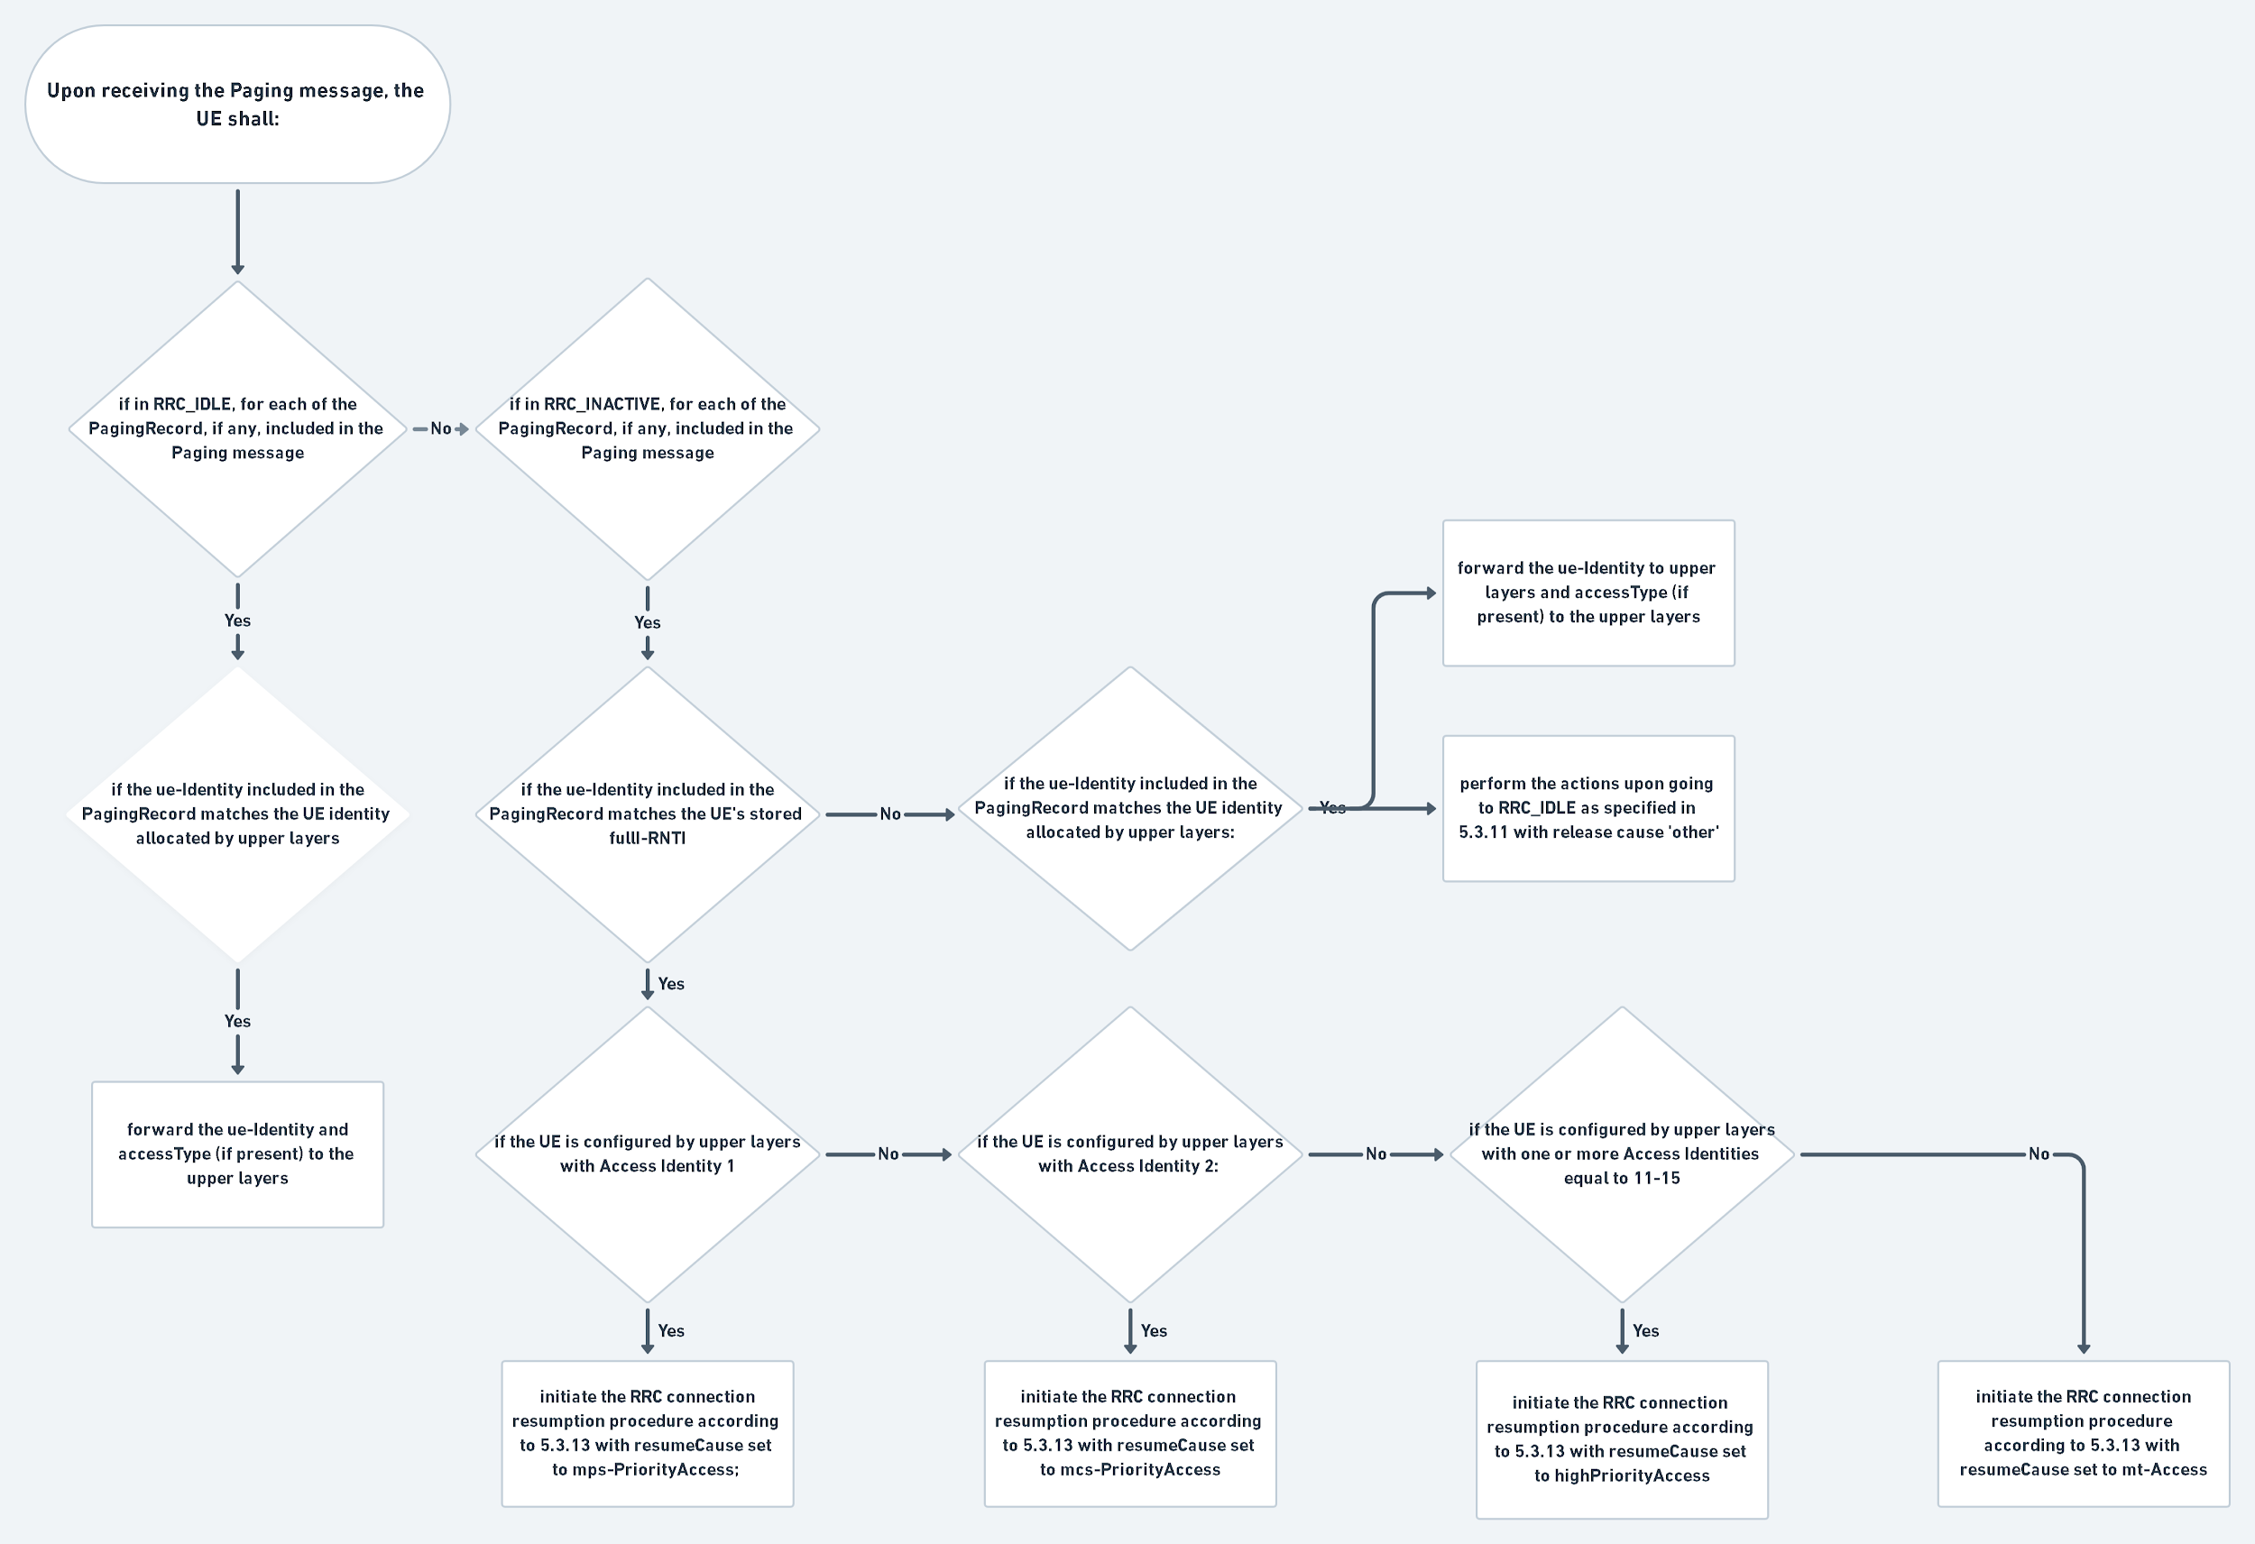
Reception of the Paging message by the UE

Slide 12
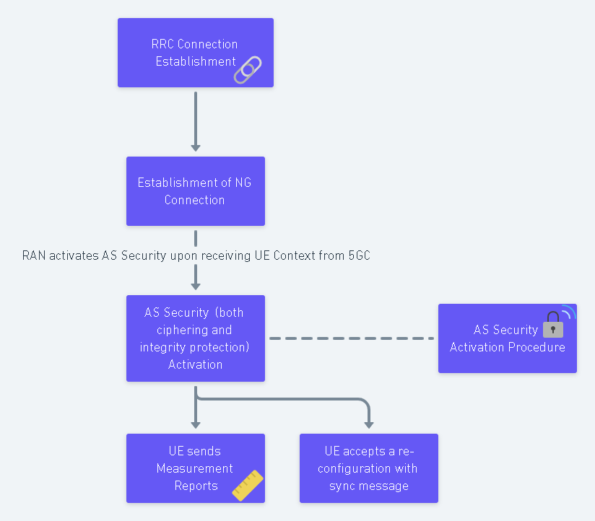
Hierarchy to be followed by AS Security Activation Procedure

Slide 13
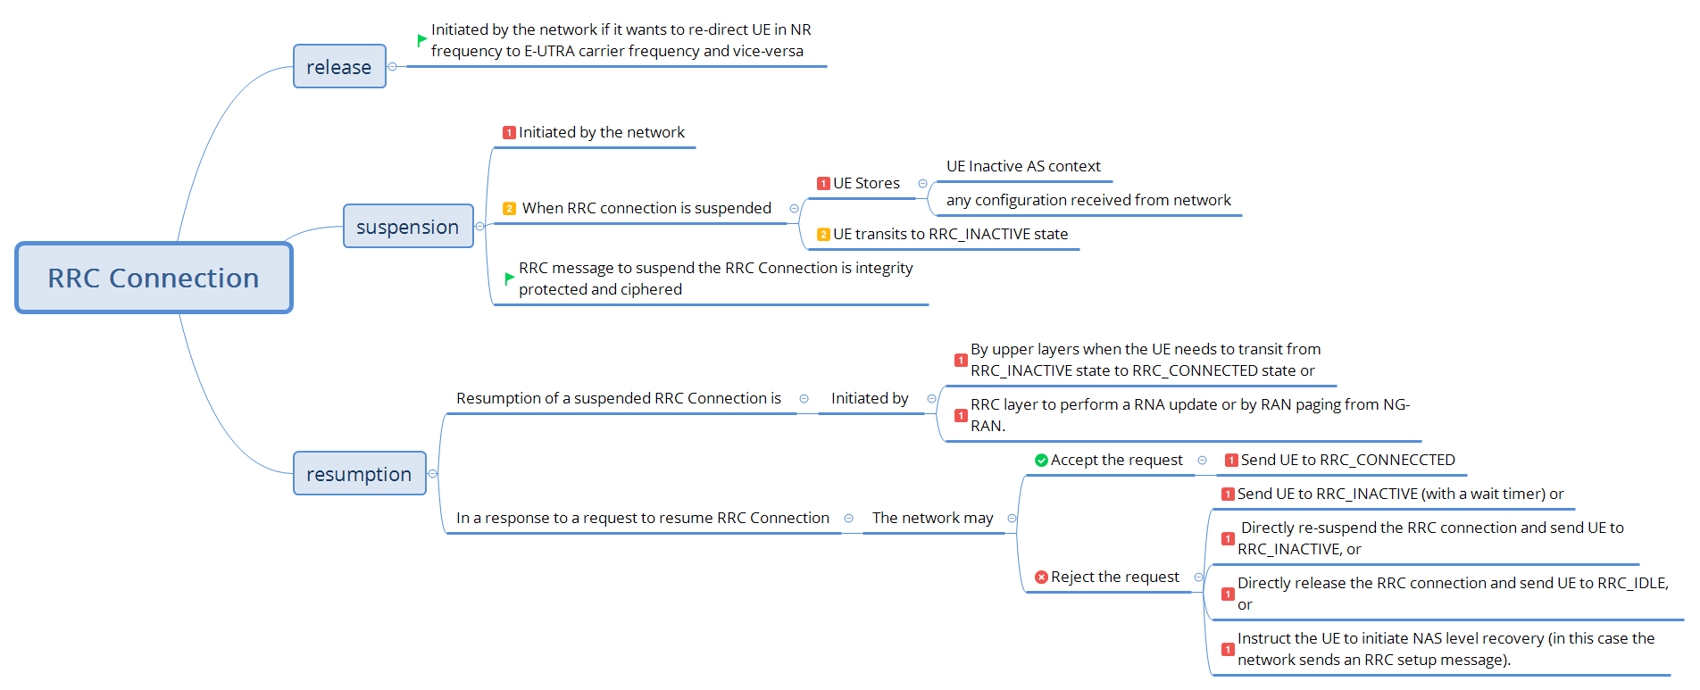
Overview of RRC Connection Procedure

Slide 14
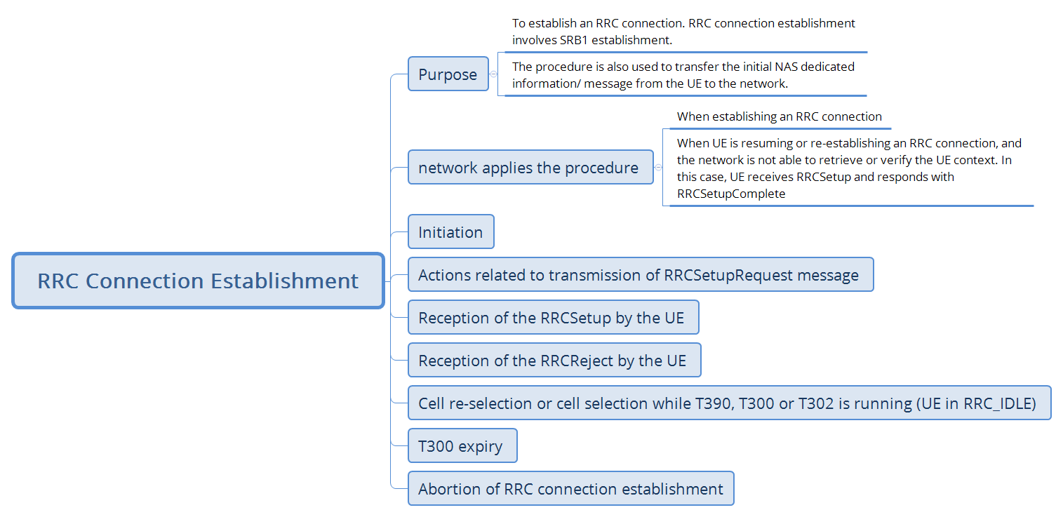
RRC Connection Establishment

Slide 15
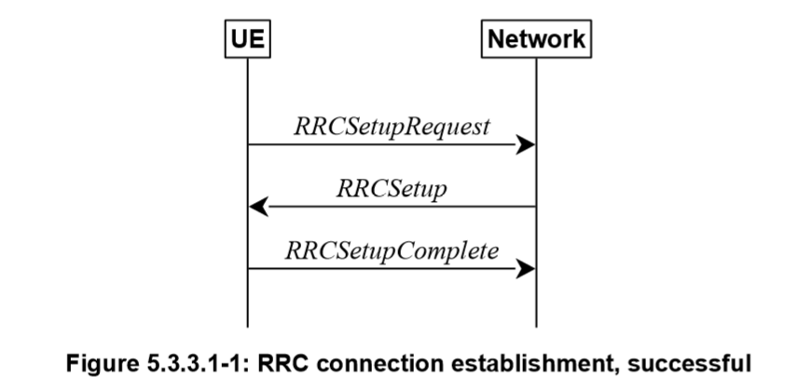
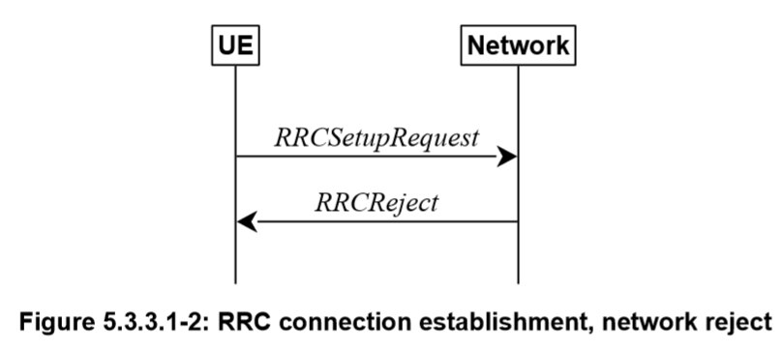

Slide 16
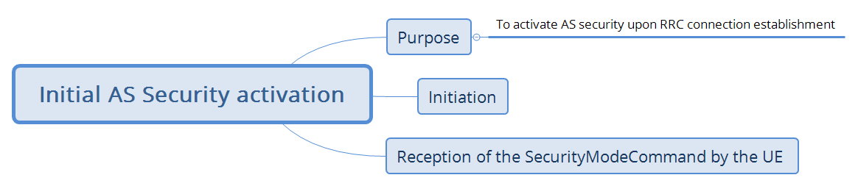
Initial AS Security Activation

Slide 17
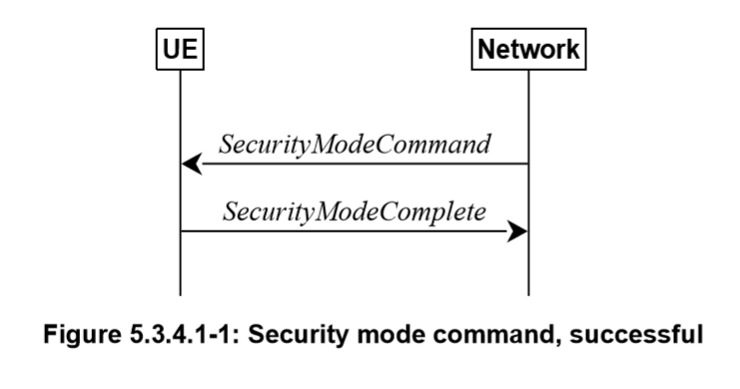
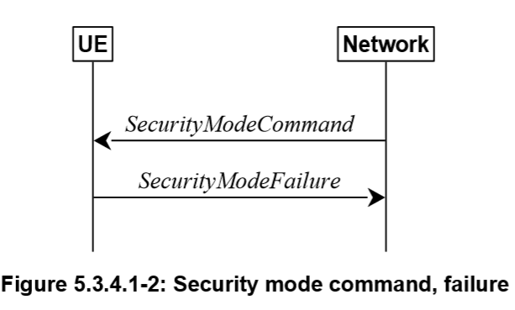

Slide 18
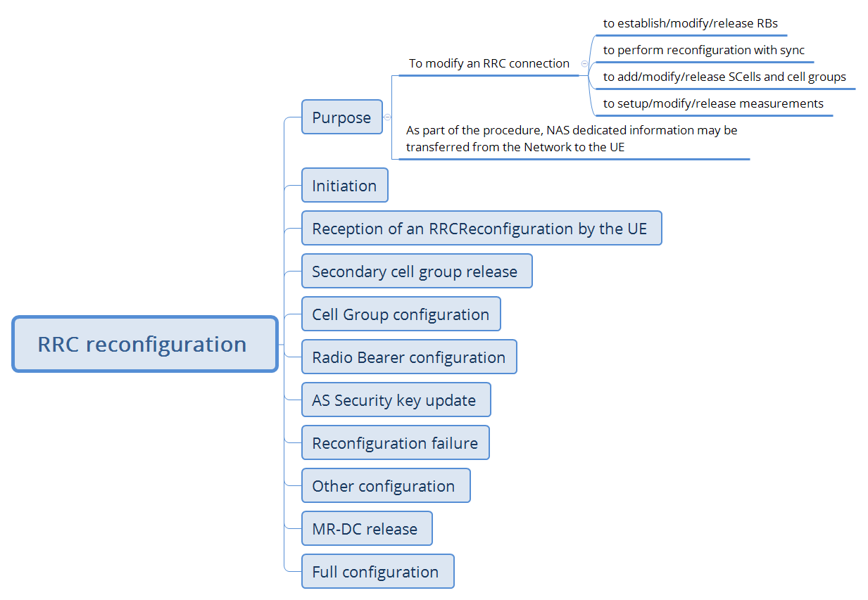
RRC reconfiguration

Slide 19
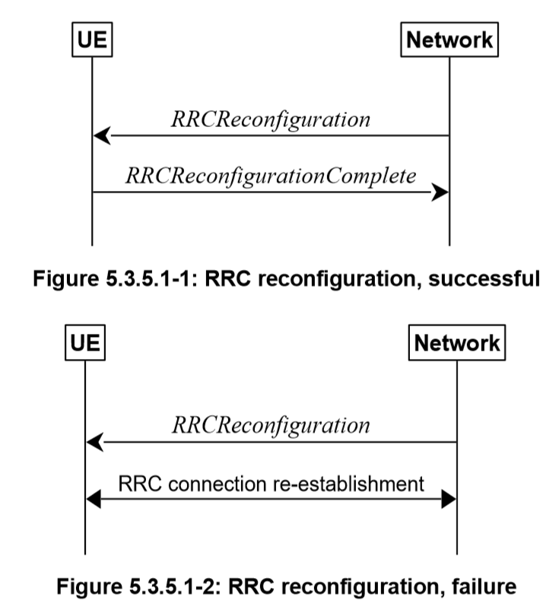

Slide 20
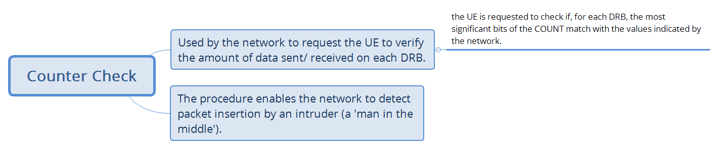
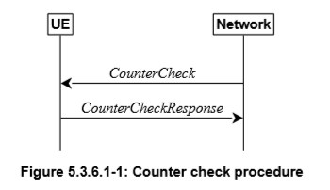
Counter Check

Slide 21
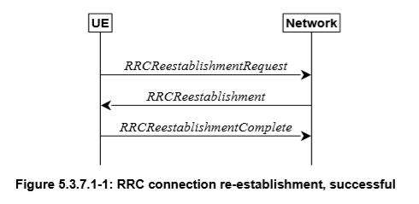
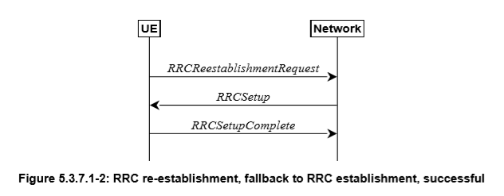
RRC Connection Re-establishment

Slide 22
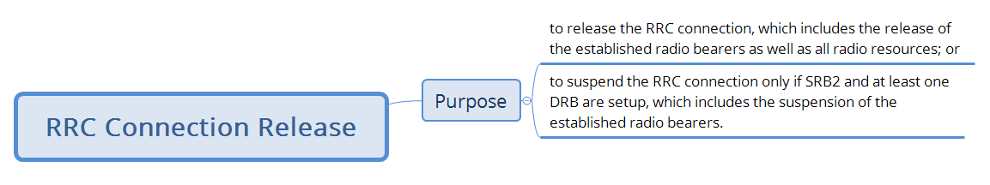
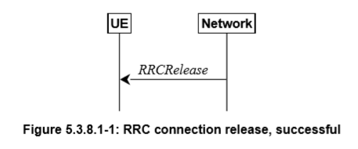
RRC Connection Release

Slide 23
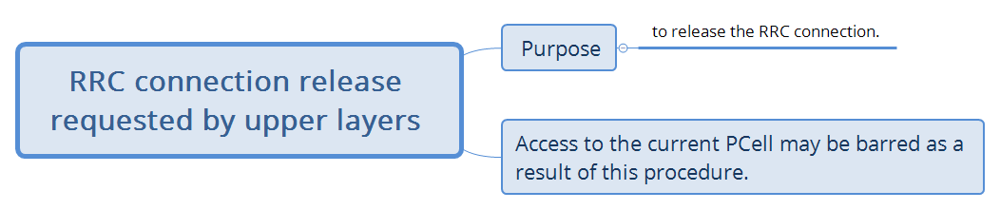
RRC Connection release requested by upper layers

Slide 24
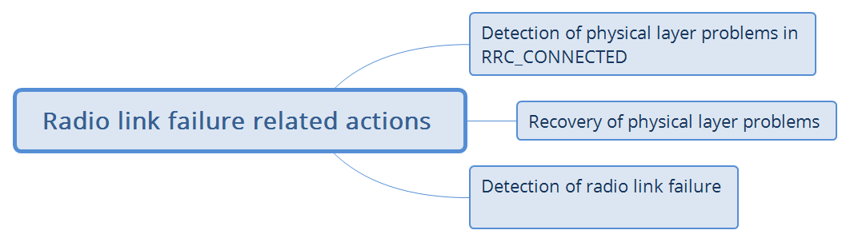
Radio link failure related actions

Slide 25
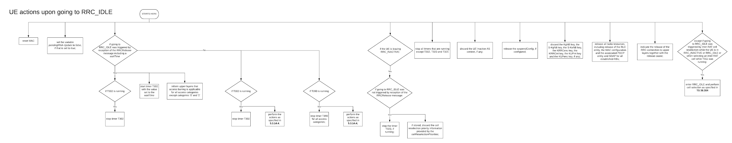
UE actions upon going to RRC_IDLE
Clear View of the flow chart can be found here

Slide 26
UE actions upon going to PUCCH/SRS release
TS 38.331
Upon receiving a PUCCH release request from lower layers, for all bandwidth parts of an indicated serving cell the UE shall:
1> release PUCCH-CSI-Resources configured in CSI-ReportConfig;
1> release SchedulingRequestResourceConfig instances configured in PUCCH-Config.
Upon receiving an SRS release request from lower layers, for all bandwidth parts of an indicated serving cell the UE shall:
1> release SRS-Resource instances configured in SRS-Config

Slide 27
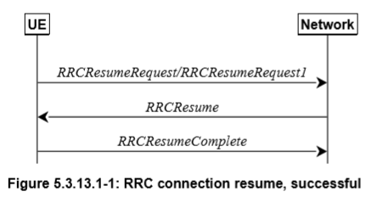
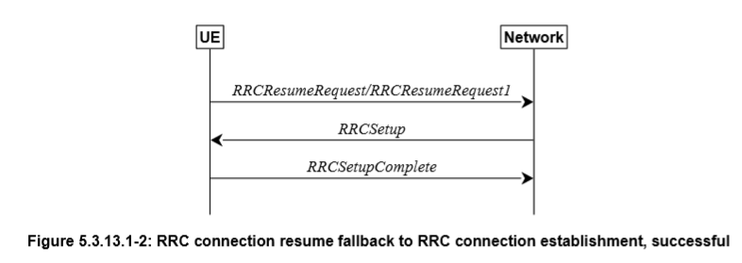
RRC Connection resume

Slide 28
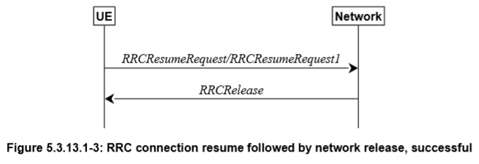
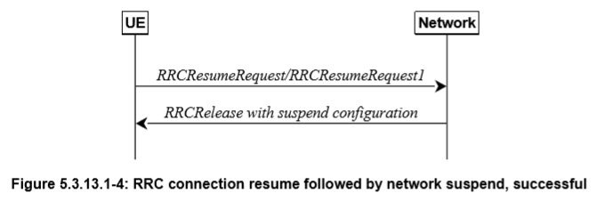

Slide 29
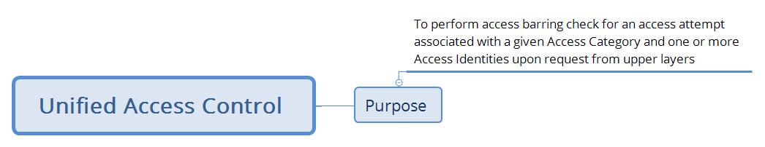
Unified Access Control

Slide 30
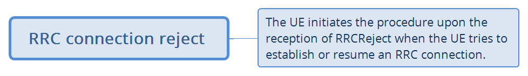
RRC Connection reject

Slide 31
Example
The RRC Connection Control involves a lot of procedures which in turn can call many other procedures.
As an example, RRC Reconfiguration procedure in RRC Connection Control is traced using a flowchart here.
The understanding of these procedures demands knowledge of IEs involved. The flowcharts were an effort to organize the IEs used in order to understand the procedure. The explanation of IEs can be found by section 6: “Protocol data units, formats and parameters” of TS 38.331 Radio Resource Control (RRC); Protocol specification.

Slide 32
Bibliography
TS 38.331 NR; Radio Resource Control (RRC); Protocol specification
http://www.sharetechnote.com/html/5G/5G_RRC_Overview.html
https://www.mpirical.com/glossary

Slide 33
Thank You

